Slide 1


Link Margin = Pr − Sensitivity
• Pt – Transmit power (dBm)
• Gt, Gr – Antenna gains (dBi)
• FSPL – Free-space path loss
• Losses – Cable, connectors, mismatch, fade
• Sensitivity – Receiver minimum detectable power
Link Margin: Difference between received power and receiver sensitivity; positive margin means reliable communication.

Slide 2

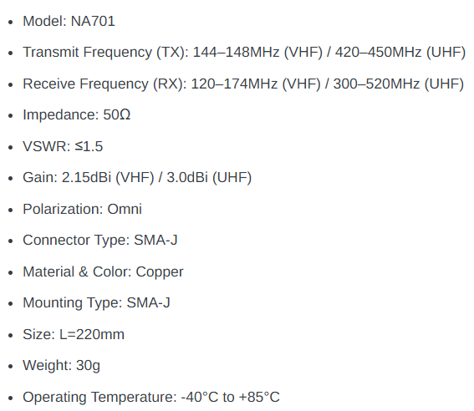
VHF Antenna (at Cubesat & Ground Station)

Slide 3
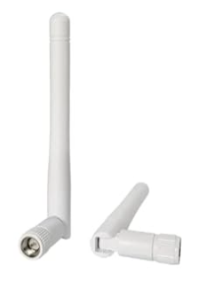
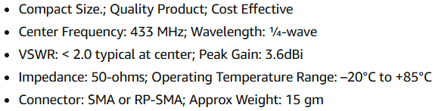
Lora Antenna for Uplink and Downlink
FSPL CALCULATION (145MHz VHF)
LFSPL = 32.44 + 20log(145) + 20log(30)
TOTAL FSPL = 32.44 + 23.223 + 29.542 = 105.205 dB
FSPL CALCULATION (433MHz LoRa)
LFSPL = 32.44 + 20log(433) + 20log(30)
TOTAL FSPL = 32.44 + 52.730 + 29.542 = 114.712 dB
FSPL CALCULATION (445MHz UHF)
LFSPL = 32.44 + 20log(430) + 20log(30)
TOTAL FSPL = 32.44 + 52.967 + 29.542 = 114.95 dB

Slide 4
VHF (NA701 Antenna)
UHF (NA701 Antenna)
LoRa Antenna 433Mhz
Parameter | Value | dB
TX Power (Pt) | 2W SA818 | +33.01 dBm
CubeSat Ant (Gt) | NA701 Quartz | +2.15 dBi
Free Space Loss | 30km @ 145MHz | -105.20 dB
Ground Ant (Gr) | NA701 Quartz | +2.15 dBi
Misc Losses | Cables/Polar | -1.0 dB
Received Power (Pr) |  | -71.90 dBm
RTL-SDR Sensitivity |  | -110 dBm
LINK MARGIN |  | +38.10 dB
Parameter | Value | dB
TX Power (Pt) | 2W SA818 | +33.01 dBm
CubeSat Ant (Gt) | NA701 Quartz | +3 dB
Free Space Loss | 30km @ 445MHz | -114.95 dB
Ground Ant (Gr) | NA701 Quartz | +3 dB
Misc Losses | Cables/Polar | -1.0 dB
Received Power (Pr) |  | -74.79 dBm
RTL-SDR Sensitivity |  | -110 dBm
LINK MARGIN |  | +35.21 dB
Parameter | Value | dB
TX Power (Pt) | 100mW SX1278 | +20.00 dBm
CubeSat Ant (Gt) | Sharvi Lora 433MHz | +3.60 dBi
Free Space Loss | 30km @ 433MHz | -114.71 dB
Ground Ant (Gr) | Sharvi Lora 433MHz | +3.60 dBi
Misc Losses | Cables/SWR | -1.0 dB
Received Power (Pr) |  | -90.51 dBm
RTL-SDR Sensitivity |  | -137 dBm
LINK MARGIN |  | +46.49 dB

